Slide 1

Kubernetes
Service Discovery

Slide 2
Introduction
Kubernetes is a very dynamic system. The system is involved in placing Pods on nodes, making sure they are up and running, and rescheduling them as needed. There are ways to automatically change the number of pods based on load. The API-driven nature of the system encourages others to create higher and higher levels of automation.
While the dynamic nature of Kubernetes makes it easy to run a lot of things, it creates problems when it comes to finding those things. Most of the traditional network infrastructure wasn’t built for the level of dynamism that Kubernetes presents.

Slide 3
What Is Service Discovery?
Service discovery tools help solve the problem of finding which processes are listening at which addresses for which services. A good service discovery system will enable users to resolve this information quickly and reliably. A good system is also low-latency; clients are updated soon after the information associated with a service changes. Finally, a good service discovery system can store a richer definition of what that service is. For example, perhaps there are multiple ports associated with the service.
The Domain Name System (DNS) is the traditional system of service discovery on the internet. DNS is designed for relatively stable name resolution with wide and efficient caching. It is a great system for the internet but falls short in the dynamic world of Kubernetes.
Real service discovery in Kubernetes starts with a Service object.
A Service object is a way to create a named label selector

Slide 4
Service DNS
(to be discussed after demonstration till step 5)
Because the cluster IP is virtual it is stable and it is appropriate to give it a DNS address. All of the issues around clients caching DNS results no longer apply. Within a namespace, it is as easy as just using the service name to connect to one of the pods identified by a service.
Kubernetes provides a DNS service exposed to Pods running in the cluster. This Kubernetes DNS service was installed as a system component when the cluster was first created. The DNS service is, itself, managed by Kubernetes. The Kubernetes DNS service provides DNS names for cluster IPs.

Slide 5
Readiness Checks
Oftentimes when an application first starts up it isn’t ready to handle requests. There is usually some amount of initialization that can take anywhere from under a second to several minutes. One nice thing the Service object does is track which of your pods are ready via a readiness check.

Slide 6
NodePort
Oftentimes the IPs for pods are only reachable from within the cluster. At some point, we have to allow new traffic in.
The most portable way to do this is to use a feature called NodePorts, which enhance a service even further. In addition to a cluster IP, the system picks a port (or the user can specify one), and every node in the cluster then forwards traffic to that port to the service.
You use the NodePort without knowing where any of the Pods for that service are running. This can be integrated with hardware or software load balancers to expose the service further.

Slide 7
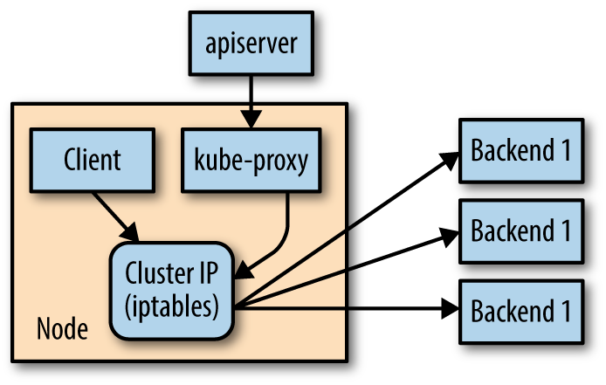
kube-proxy and Cluster IPs
Cluster IPs are stable virtual IPs that load-balance traffic across all of the endpoints in a service. This magic is performed by a component running on every node in the cluster called the kube-proxy. the kube-proxy watches for new services in the cluster via the API server. It then programs a set of iptables rules in the kernel of that host to rewrite the destination of packets so they are directed at one of the endpoints for that service. If the set of endpoints changes for a service the set of iptables rules is rewritten.

Slide 8
The cluster IP itself is usually assigned by the API server as the service is created. However, when creating the service, the user can specify a specific cluster IP. Once set, the cluster IP cannot be modified without deleting and recreating the Service object.
While most users should be using the DNS services to find cluster IPs, there are some older mechanisms that may still be in use. One of these is injecting a set of environment variables into pods as they start up.
A problem with the environment variable approach is that it requires resources to be created in a specific order. The services must be created before the pods that reference them. This can introduce quite a bit of complexity when deploying a set of services that make up a larger application. In addition, using just environment variables seems strange to many users. For this reason, DNS is probably a better option

Slide 9
Demonstration

